Slide 1
Seasonal adjustment
ESTP-training
15-17/10/2024

Slide 2
0. Outline
ESS guidelines
Objectives
Methods
Series decomposition
Overview of seasonal adjustment methods
Outline of the training
Final remarks

Slide 3
1. ESS Guidelines (2024)
Background and basic definitions
Seasonal adjustment is a fundamental process in the correct interpretation of short-term time series movement to inform policy makers.
Seasonal fluctuations and calendar effects can mask short and long-term movements in a time series and impede a clear understanding of underlying phenomena. Seasonal adjustment filters out usual seasonal fluctuations and typical calendar effects from a time series.
Usual seasonal fluctuations mean those movements which recur with similar intensity in the same season each year and which, based on the past movements of the time series in question and under normal circumstances, can be expected to recur. Calendar effects arise from annual differences in the number of working or trading days in a month or a quarter, or the dates or days of public holidays.

Slide 4
Movements due to exceptionally strong or weak seasonal influences, for example extreme weather conditions or atypical holiday patterns, will continue to be visible in the seasonally adjusted series. Other random disruptions and unusual movements with real-world interpretations, for example strikes or large orders, will also continue to be visible.
Hence, the seasonally adjusted results do not show “normal” and repeating events but do show the “news” in the time series, for example latest movements of the trend, the business cycle or the irregular components as well as the occurrence of turning points.
The downside of seasonal adjustment is that seasonality cannot be precisely defined and different approaches – such as the signal extraction approach (Burman, 1980; Gomez and Maravall, 1996) and the semi-parametric approach based on a set of predefined moving (Shiskin et al., 1967; Findley et al., 1998) – may result in different outcomes.
The expertise of an analyst will also impact on the quality of seasonal adjustment, although the primary drivers are the quality of the unadjusted time series and the production timetable.

Slide 5
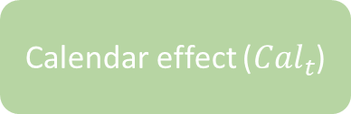
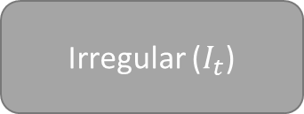

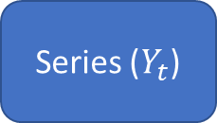

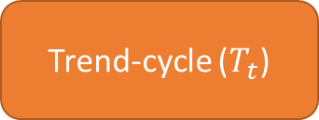
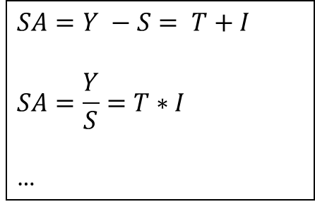
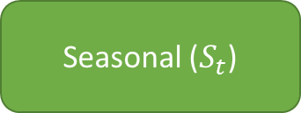
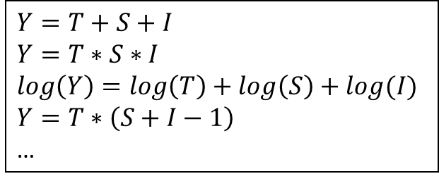
2. Series decomposition
Calendar effect (${Cal}_{t}$)
Seasonal ($S_{t}$)
Seasonally adj (${SA}_{t}$)
Series ($Y_{t}$)
$$Y=f(T, S,I)$$
Trend-cycle ($T_{t}$)
$$SA=Y −S= T+I$$
$$SA=\frac{Y}{S}=T∗I$$
…
$$Y=T+S+I$$
$$Y=T∗S∗I$$
$$\log\left(Y\right)=\log\left(T\right)+\log\left(S\right)+log(I)$$
$$Y=T∗\left(S+I−1\right)$$
…
Irregular ($I_{t}$)

Slide 6
2. Series decomposition
Trend-cycle
Smooth (?)
Around the series
Seasonal
Periodic, with slow changes (?)
Nearly 0 or 1 in average during 1 cycle (year)
Irregular
Residual
Around 0 or 1
No actual definition of the components ⇒ Methods/software give different results

Slide 7
3. Rapid overview of the main SA methods
Non parametric
Parametric
Machine learning
Lo(w)ess
Moving averages
Stochastic
Deterministic
RegArima
models
Structural models
Prophet
STL
X11
Canonical decomposition
Stamp,
RegCmp,
(T)Bats,
…
X12-ARIMA
Kalman filter
WK filter
Tramo-Seats

Slide 8
3. Rapid overview of the main SA methods
Non parametric
Parametric
Machine learning
Lo(w)ess
Moving averages
Stochastic
Deterministic
JD+ 2.x
RegArima
models
Structural models
Prophet
STL
X11
Canonical decomposition
X12-ARIMA
Kalman filter
WK filter

Slide 9
3. Rapid overview of the main SA methods
Non parametric
Parametric
Machine learning
Lo(w)ess
Moving averages
Stochastic
Deterministic
JD+ 3.0
RegArima
models
Structural models
Prophet
STL
X11
Canonical decomposition
X12-ARIMA
Kalman filter
WK filter

Slide 10
4. Outline of the training (see guidelines)
Overview of (R)JDemetra+
JD+ 3.0, rjdverse, github, documentation…
Short tutorial on time series
Pre-treatment
Decomposition scheme, outliers, calendar effects, (automatic) model selection
Decomposition (seasonal adjustment)
Seats, X11, STL, STS…
Revisions
Quality control
Routine SA processing
Specific issues
Pre-treatment, decomposition
High-frequency

Slide 11
5. Final remarks
Need to understand the principles of the main algorithms (not all the technical details)
Software automates many details
Need for good quality reports
Recall: “seasonally adjusted series should have neither residual seasonality nor residual calendar effects”
Need to “industrialize” the seasonal adjustment processing
Additional request: “Seasonal adjustment procedures should generate consistent and robust results”

